Slide 1
Development of Machine Learning Model for Schizophrenia Diagnosis Using Brain Transcriptomics
Present by: Chin Wee Jian
Authors: Ir. Dr. Goh Choon Hian，Dr. Tang Pek Yee, Dr. Mok Siew Ying

Slide 2
01
Introduction

Slide 3
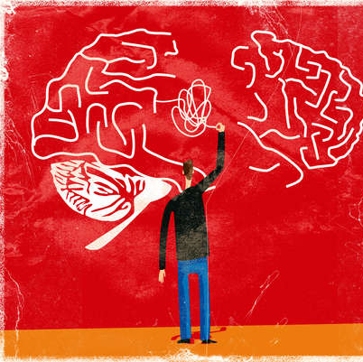
Schizophrenia
Psychiatric disorder
Hallucinations, delusions, and thought disorder
1 in 300 people (0.32%) worldwide
24 million people
More than two out of three patient do not receive specialist mental health care
Notes:
When it's still confined to the prostate gland has the best chance for successful treatment

Slide 4
Symptoms
Persistent delusions
Persistent hallucinations
Experiences of influence, control or passivity
Disorganized thinking
Highly disorganised behaviour
Negative symptoms such as limited speech, inability to experience or express emotion and interest
Extreme agitation or slowing of movements, maintenance of unusual postures.
Notes:
persistent delusions: the person has fixed beliefs that something is true, despite evidence to the contrary;
persistent hallucinations: the person may hear, smell, see, touch, or feel things that are not there;
experiences of influence, control or passivity: the experience that one’s feelings, impulses, actions, or thoughts are not generated by oneself, are being placed in one’s mind or withdrawn from one’s mind by others, or that one’s thoughts are being broadcast to others;
disorganized thinking, which is often observed as jumbled or irrelevant speech;
highly disorganised behaviour e.g. the person does things that appear bizarre or purposeless, or the person has unpredictable or inappropriate emotional responses that interfere with their ability to organise their behaviour;
“negative symptoms” such as very limited speech, restricted experience and expression of emotions, inability to experience interest or pleasure, and social withdrawal; and/or
extreme agitation or slowing of movements, maintenance of unusual postures.

Slide 5
Problem Statement
Genes and a range of environmental factors
Absence of objective diagnostic methods
Hampers early detection and delays treatment
Diagnostic
Through brain transcriptomics
Complexity and sheer volume of transcriptomic data
Large-scale genome expression profiling
Biomarkers
Reduce number of candidate genes
Validation can achieve in real clinical cohorts
Identifying accurate markers remain challenging
Accuracy & Accessibility
Notes:
Not identified cause of schizophrenia
Interaction between genes and a range of environmental factors
Absence of objective diagnostic methods
Hampers early detection and delays treatment
Identifying molecular biomarkers through brain transcriptomics offers significant insights into the underlying biology of schizophrenia.
However, the complexity and sheer volume of transcriptomic data present significant challenges in analysing and interpreting these data effectively.
Large-scale genome expression profiling is a high-cost assays.
If the number of candidate genes can be reduced, validation could be achieved in real clinical cohorts.
Nevertheless, identifying accurate markers remains challenging due to various confounding factors.

Slide 6
Objective
To develop a classification machine learning model for schizophrenia diagnosis based on selected genes that exhibit high differentially expression in the brains of individuals diagnosed with schizophrenia.
Contribution of Study
Ultimately, this model could enhance diagnostic accuracy and shed light on underlying disease mechanisms, potentially leading to new therapeutic targets.

Slide 7
02
Methodology

Slide 8
Algorithm Flowchart
Gene Expression Omnibus (GEO)
GSE87194
|log2FC| > 1
p-value < 0.05
Random Forest
SVM Algorithm
Data Acquisition
Data
Pre-processing
Differential Expression Analysis
Feature Selection
Classification
Model

Slide 9
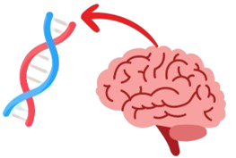
1. Data Acquisition
Gene Expression Omnibus (GEO) database
Publicly available gene expression profiling data
GSE87194 (brain)
RNA sequences data
Post-mortem tissue of the dorsolateral prefrontal cortex
19 Schizophrenia patients & 19 Normal control sample
https://www.ncbi.nlm.nih.gov/geo/query/acc.cgi?acc=GSE87194

Slide 10
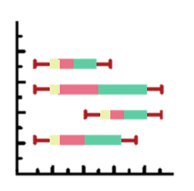
2. Data Pre-processing
Removed low-expressed genes
1 and 2 expression values
Trimmed mean of M values (TMM) normalization
Library size variation
Sequencing depth
Abrams, Z.B., Johnson, T.S., Huang, K. et al. (2019) A protocol to evaluate RNA sequencing normalization methods. BMC Bioinformatics 20 (Suppl 24), 679. https://doi.org/10.1186/s12859-019-3247-x

Slide 11
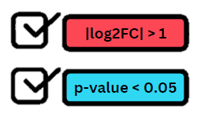
3. Differential Expression Analysis
Differential Analysis:
Python Package edgeR
Identify genes exhibiting different expression levels
Between patient and control
Criteria:
|log2FC| > 1
p-value < 0.05
McDermaid, A., Monier, B., Zhao, J., Liu, B., & Ma, Q. (2018). Interpretation of differential gene expression results of RNA-seq data: review and integration. Briefings in Bioinformatics, 20(6), 2044–2054. https://doi.org/10.1093/bib/bby067

Slide 12
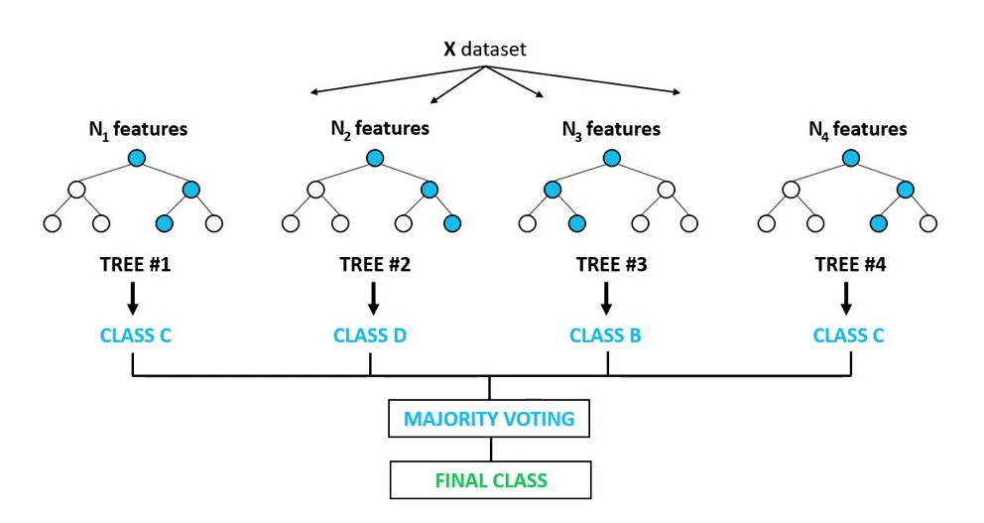
4. Feature Selection
Random Forest Algorithm
Select top 20 genes
Based on the important Score
n_estimators=100
random_state=randomset
Train-test Split (7:3)

Slide 13
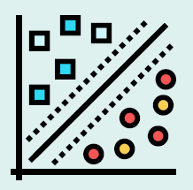
5. Classification Model Design
Support Vector Machine (SVM) Algorithm
Optimized hyperparameters using Grid Search
C: 0.001, 0.01, 0.1, 1, 10, 100
gamma: 1, 0.1, 0.01, 0.001, 0.0001
kernel: rbf, linear, poly
5-fold cross-validation to assess model performance
Train-Test Split (8:2)

Slide 14
03
Result and Discussion

Slide 15
DATABASE
42358 features
DEA
1806 features
FEATURE SELECTION
20 features
Top 20 Features For Schizophrenia Classification
Protein coding gene | Antisense gene | Non-coding RNA | Pseudogene
ACOXL PIK3R6 CRLF1 | SLC22A18AS | AC008781.1 RP11-403I13.7.1 RP11-728F11.1.1 AC018890.6.1 P4HA2-AS1 RP11-439L18.2.1 SNORD115-47 RP11-50D9.3.1 C6orf195 | CTC-342P15.1.1 OR52H2P GS1-304P7.1.1 RBMX2P3 RPS8P6 MTCYBP3 ISCA2P1
Note:
Upregulated
Downregulated

Slide 16
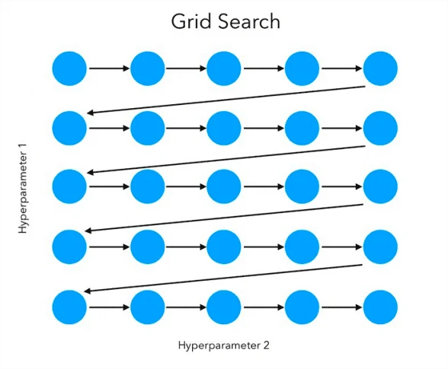
Tuned Hyperparameters for SVM model
Kernel = rbf
Radial basis function
C = 1
Regularization Parameter
Gamma = 0.1
Kernel coefficient

Slide 17
Performance Evaluation
Model Performance after 5-Fold Cross Validation
Mean Accuracy | 0.9214
Mean Precision | 0.8814
Mean Recall | 1.0000
Mean F1-score | 0.9338

Slide 18
Function of the genes
ACOXL
Lipid metabolism
Homeostasis
Neuronal membrane integrity
Neurotransmitter function
Myelin maintenance
PIK3R6
Phosphoinositide 3-kinase gamma
Neurodevelopment
Synaptic neuroplasticity
Neuronal survival signalling

Slide 19
Function of the genes
CRLF1
Cytokine receptor-like factor 1
Nerve cell development and function
Motor neurons
Cognition, emotion regulation
Sensory processing
SLC22A18AS
Downregulate the expression of SLC22A18 gene
Brain tumor suppressor
Promoter methylation associated with glioma

Slide 20
04
Conclusion and Future Direction

Slide 21
Conclusion
The machine learning model achieved a high schizophrenia diagnostic accuracy of 92%, identified key biomarkers, and enhanced the potential for earlier detection.
Future Direction
Compare gene expression in brain and peripheral blood to identify key schizophrenia biomarkers, utilizing the accessibility of peripheral blood for diagnosis.

Slide 22
Thanks!

Slide 23
Q & A

