Slide 1








14th Mind-Body Interface International Symposium
Minds & Megabytes: Optimizing Mental Health in the Digital Age
Taichung, 20 October 2024
The effect of a probiotic formulation on modulating peripheral inflammation and bacterial-derived metabolite levels in Alzheimer's Disease patients
Elisa Mombelli
Biological Psychiatric Unit
IRCCS Fatebenefratelli San Giovanni di Dio
Brescia, Italy

Slide 2

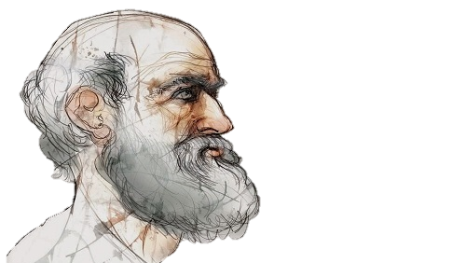
« ALL DISEASE BEGINS IN THE GUT »
- Hippocrates

Slide 3
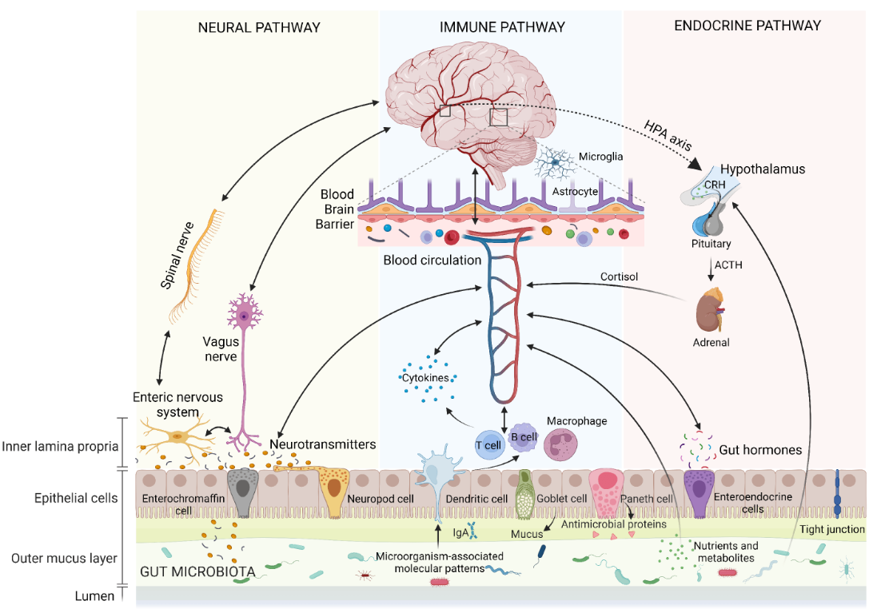
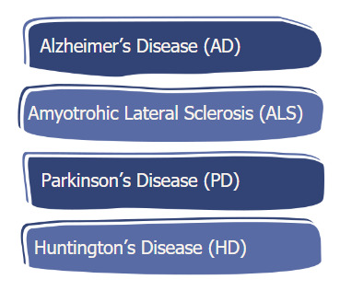
Gut-brain axis: involvement in neurodegenerative diseases
Pathways involved in bidirectional communication within the gut–brain axis (GBA).
From Zheng Y et al., Nutrients, 2023.

Slide 4
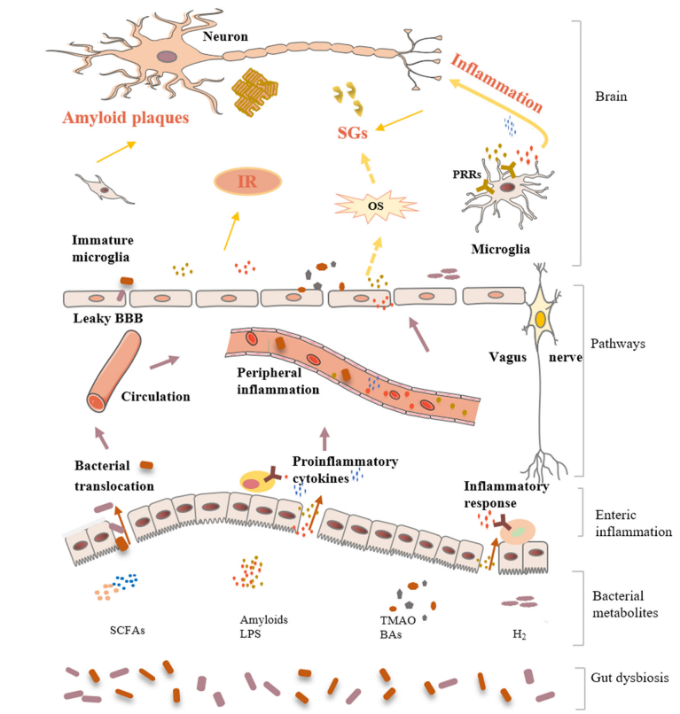


Gut Dysbiosis in Alzheimer’s Disease
Impact of gut dysbiosis on AD.
From Liu S et al. Mol Neurobiol. 2020.

Slide 5
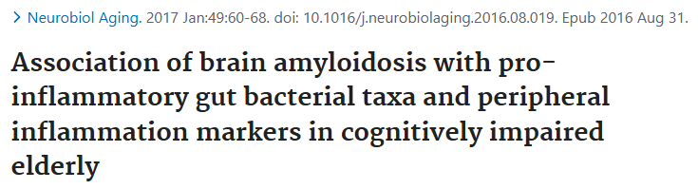
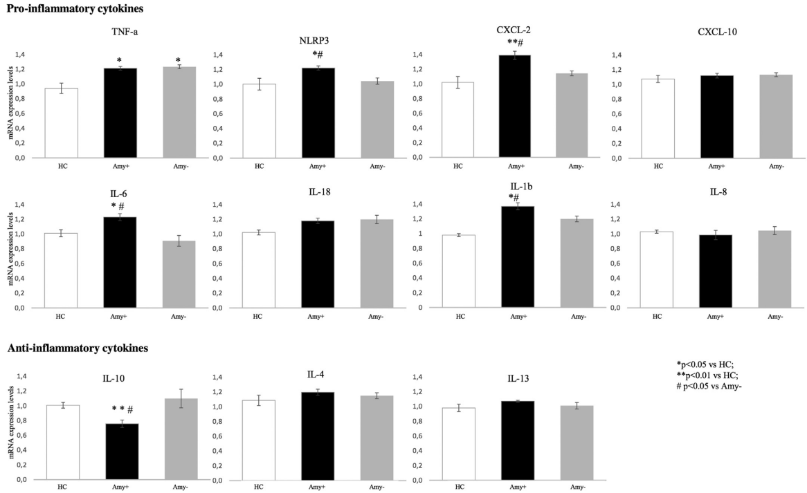
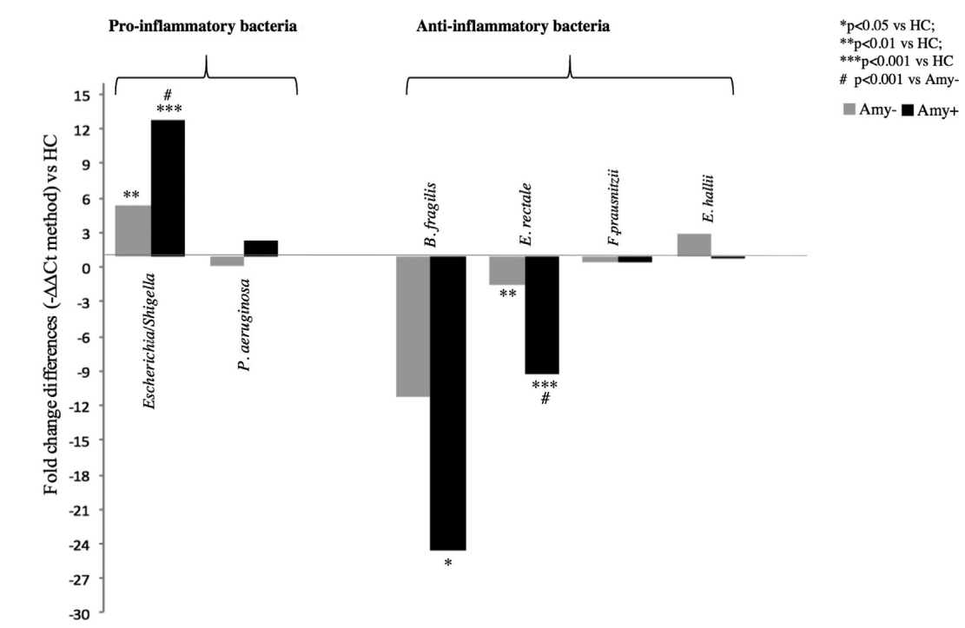
Brain amyloidosis is linked to blood and gut inflammatory signatures in cognitively impaired subjects
Pro-inflammatory cytokines
Cattaneo A et al. Neurobiol Aging. 2017.
doi:10.1016/j.neurobiolaging.2016.08.019
HC
Amy+
Amy-
HC
Amy+
Amy-
HC
Amy+
Amy-
HC
Amy+
Amy-
HC
Amy+
Amy-
HC
Amy+
Amy-
HC
Amy+
Amy-
HC
Amy+
Amy-
Anti-inflammatory cytokines
HC
Amy+
Amy-
HC
Amy+
Amy-
HC
Amy+
Amy-
HC → cognitively healthy amyloid-negative controlspatients
Amy+ → cognitively impaired amyloid-positive
Amy- → cognitively impaired amyloid-negative patients

Slide 6
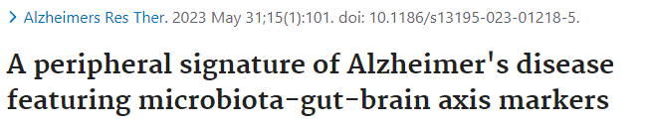
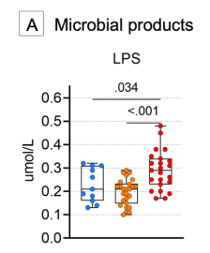
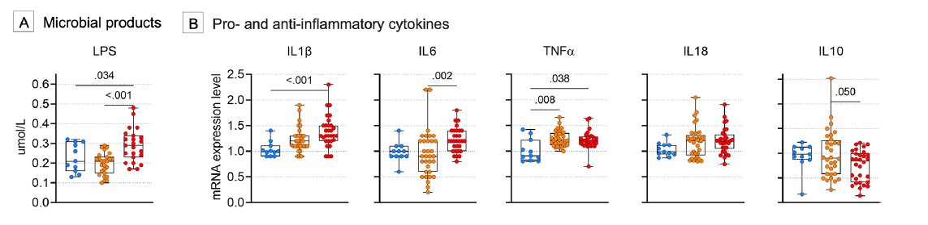
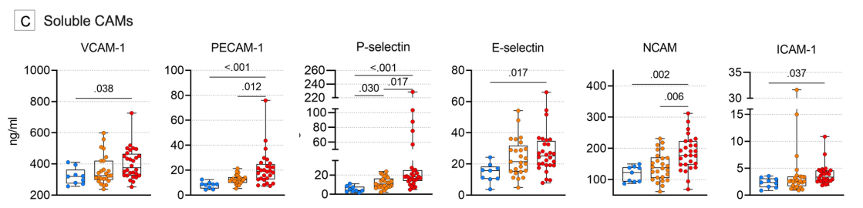
Dysregulated gut-brain axis in patients with Alzheimer’s Disease
Marizzoni M et al. Alzheimers Res Ther. 2023. doi: 10.1186/s13195-023-01218-5
Cognitively unimpaired
Cognitively impaired not due to AD
Cognitively impaired due to AD
Cognitively unimpaired
Cognitively impaired not due to AD
Cognitively impaired due to AD

Slide 7
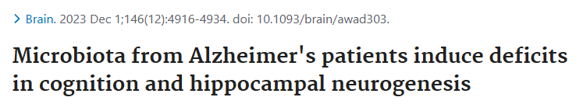
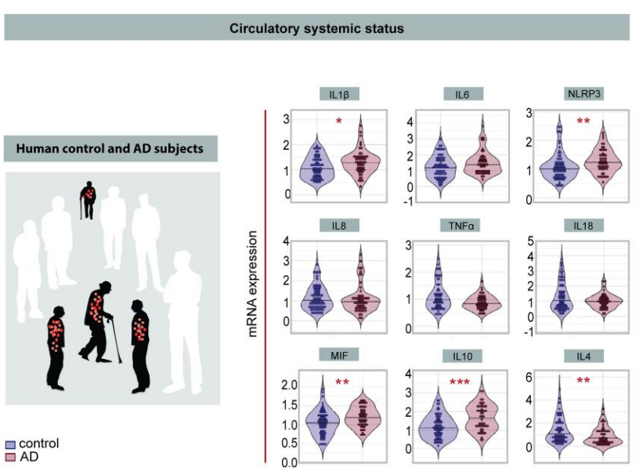
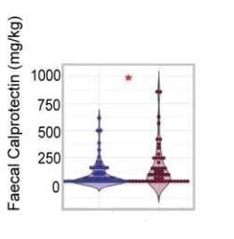
Peripheral and intestinal pro-inflammatory signature in patients with Alzheimer’s Disease
Grabrucker S et al. Brain. 2023. doi:10.1093/brain/awad303
Circulatory systemic status
Intestinal inflammation
p=0.018
p=0.003
p=0.022
p=0.008
p<0.001
p=0.006

Slide 8
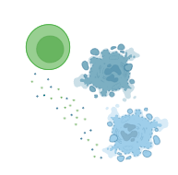

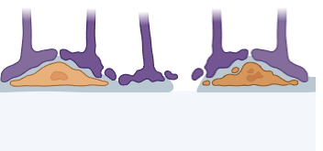

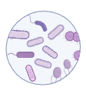
Aim of the study
Altered peripheral inflammation
↑ Pro-inflammatory cytokines
↓ Anti-inflammatory cytokines
Is it possible to modulate dysregulated peripheral processes associated with Alzheimer’s Disease by targeting the gut-brain axis?
Altered barriers integrity
Imbalanced GMB composition
↑ Pro-inflammatory bacteria
↓ Anti-inflammatory bacteria
Altered microbial metabolites
Imbalanced GMB composition
↑ Pro-inflammatory bacteria
↓ Anti-inflammatory bacteria
Altered microbial metabolites

Slide 9
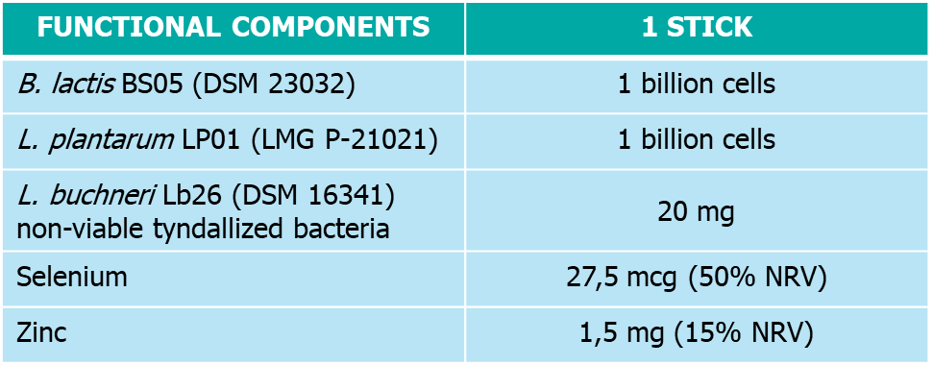




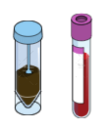
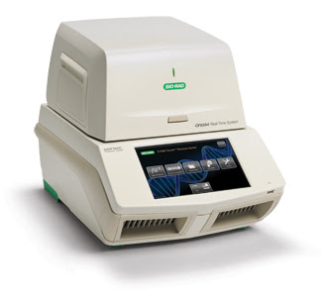
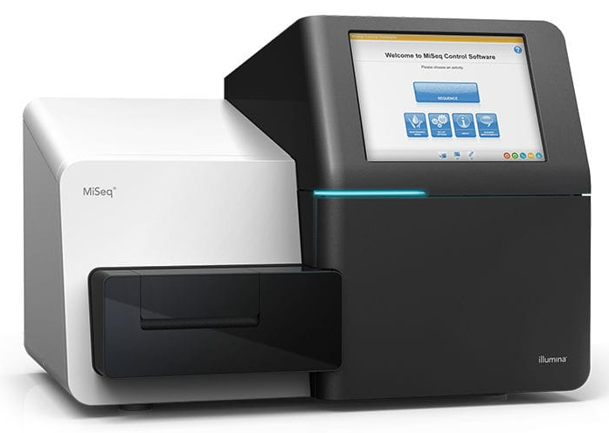
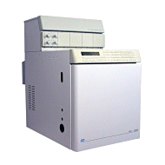
Experimental design
T0
T1
T4
n = 41
● Cognitive assessment (ACE-R/MMSE, CDR)
● Psychological assessment (CSDD)
Psychological assessment (CSDD)
Psychological assessment (CSDD)
Candidate gene expression analysis
Gut microbiota composition analysis and SCFAs quantification
ACE-R: Addenbrooke's Cognitive Examination – Revised; MMSE: Mini-Mental State Examination; CDR: Clinical Dementia Rating Scale; CSDD: Cornell Scale for Depression in Dementia.

Slide 10
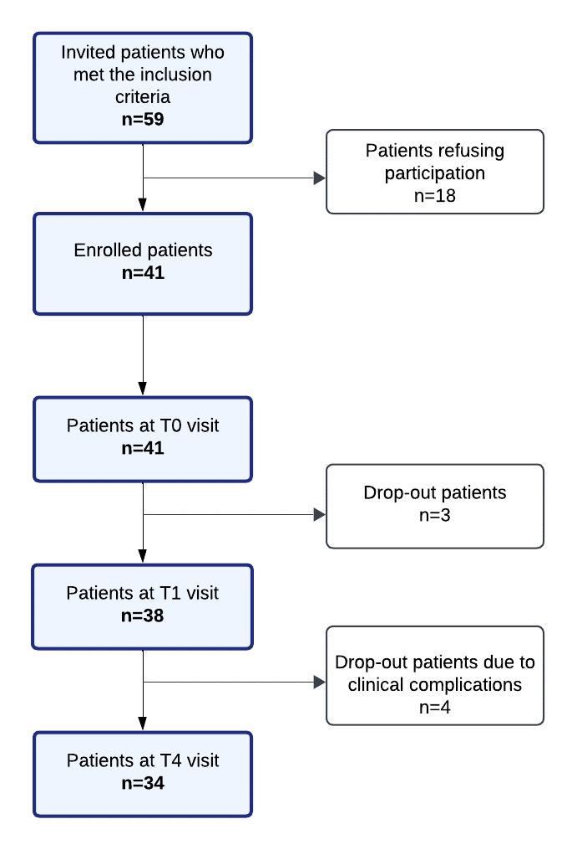
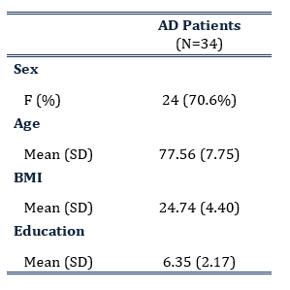
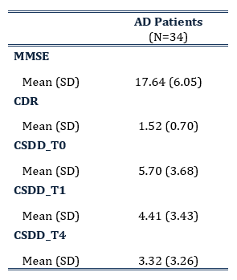
Recruitment flow-chart and clinical and demographic features of patients
Demographics
Clinical features

Slide 11
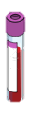
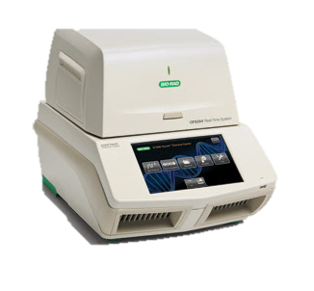
Probiotic supplementation modulates the levels of inflammatory mediators
IL6
NLRP3
TNFalpha
IL10
IL4
0.011
0.006
0.011
<0.001
0.039
It recruits immune cells and triggers B and T cell response.
It contributes to inflammation by inducing cytokine maturation.
It drives inflammatory responses by directly inducing inflammatory gene expression and indirectly by causing cell death.
It exerts a neuroprotective role through anti-inflammatory and anti-apoptotic properties.
Neutralizes the neuroinflammation sustained by pro-inflammatory cytokines.
↓ PRO-INFLAMMATORY MEDIATORS
↑ ANTI-INFLAMMATORY MEDIATORS

Slide 12
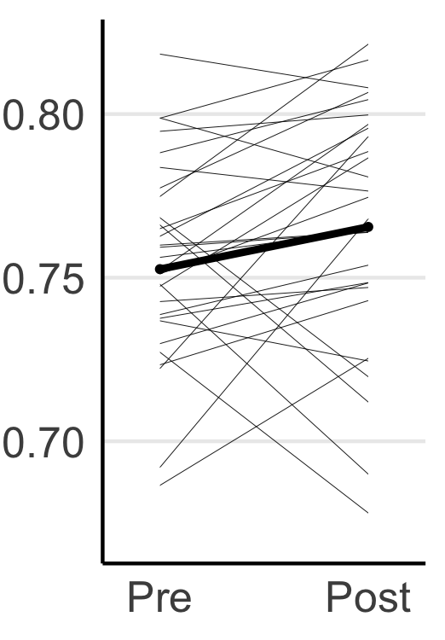
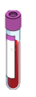
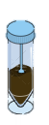
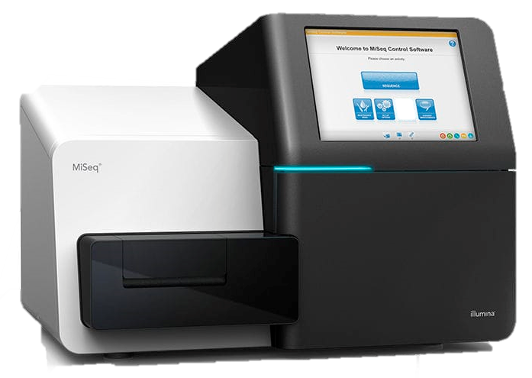
Probiotic supplementation modulates microbiota diversity and metabolites
Pielou’s evenness
Valerate
Butyrate
0.070
0.005
0.005
Index of diversity and species richness.
0 → all bacteria belong to a single species
1 → all species have an equal number of individuals
Increases the expression of pro-inflammatory cytokines and compromises the integrity of the blood-tissue barrier.
Maintains intestinal integrity and modulates immune responses by decreasing the production of pro-inflammatory cytokines.
↓ PRO-INFLAMMATORY PROPERTIES
↑ ANTI-INFLAMMATORY PROPERTIES

Slide 13
Specific bacterial genera are associated with changes in the levels of peripheral inflammation and microbial products
Lachnospiraceae FCS020 group
Reduced abundance in Parkinson’s Disease
(Lubomski M. et al., Front. Aging Neurosci. 2022)
Risk factor for Alzheimer’s Disease
(Ji D. et al., J Neuroinflammation 2024)
Negatively associated with VLDL lipoproteins
(Vojinovic D. et al, Nature Comm 2019)
Pre
Post
Pre
Post
Pre
Post
d_IL6
d_NLRP3
d_TNFalfa
Anaerostipes
Butyrate-producing bacteria
(Duncan S.H. et al., Appl Environ Microbiol 2004)
Reduced abundance in inflammatory bowel diseases, irritable bowel syndrome and metabolic disorders
(Lo Presti A. et al., Front Microbiol 2019; Zeevi D. et al., Nature 2019)
Positively associated with HDL lipoproteins
(Vojinovic D. et al, Nature Comm 2019)
g_Anaerostipes
g_Anaerostipes
Pre
Post
Pre
Post
d_Butyrate
d_Valerate

Slide 14

Concluding remarks
Probiotic supplementation is able to:
Slightly reduce depressive symptomatholgy;
Down-regulate genes implicated in pro-inflammatory processes and up-regulate those with anti-inflammatory functionalities;
Decrease levels of pro-inflammatory SCFAs and enhance amounts of beneficial SCFAs;
Induce changes in relative abundance of several bacterial genera, specifically Lachnospiraceae FCS020 group and Anaerostipes, whose changes are associated with modulation of inflammatory and metabolic peripheral features.
↓
Probiotic products can modulate peripheral alterations found in different cohorts of patients with Alzheimer’s Disease
Altered peripheral inflammation
↑ Pro-inflammatory cytokines
↓ Anti-inflammatory cytokines
Altered barriers integrity
Imbalanced GMB composition
↑ Pro-inflammatory bacteria
↓ Anti-inflammatory bacteria
Altered microbial metabolites

Slide 15





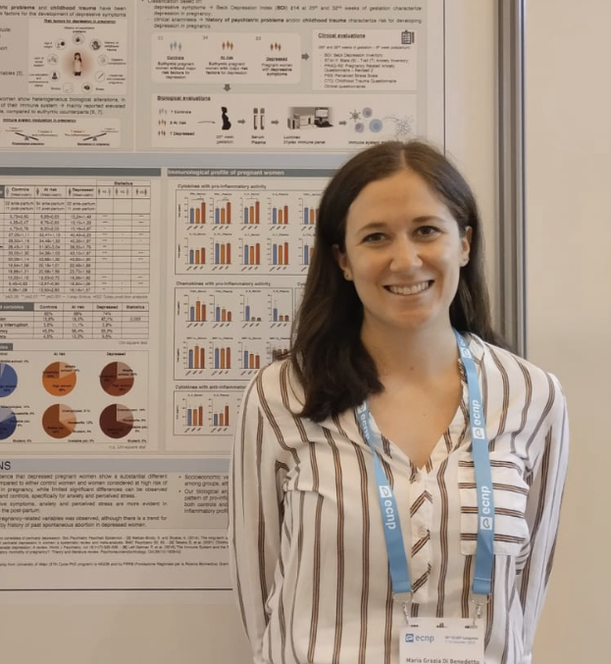
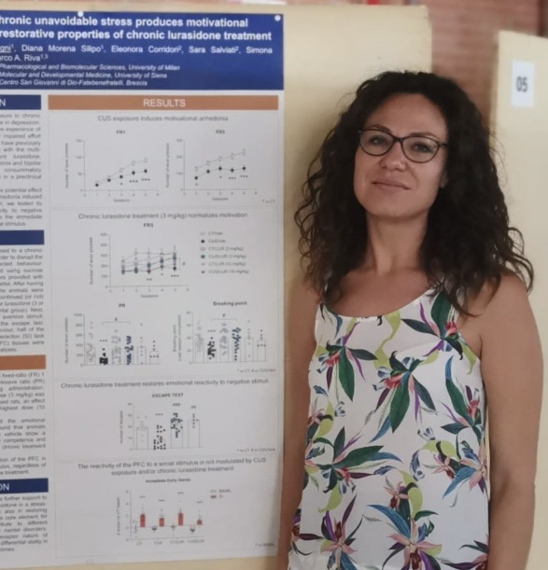
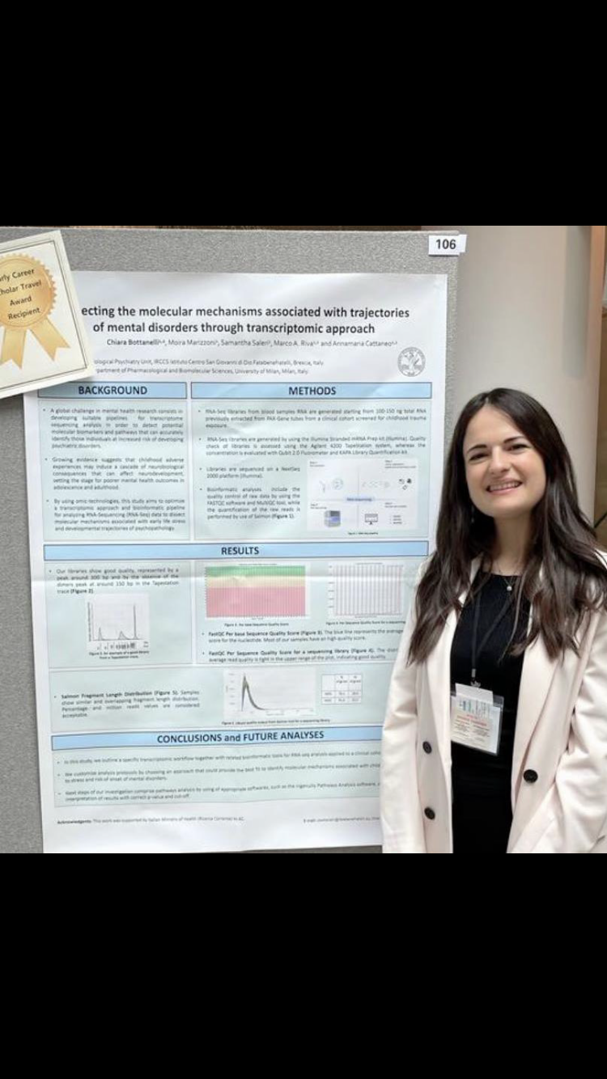
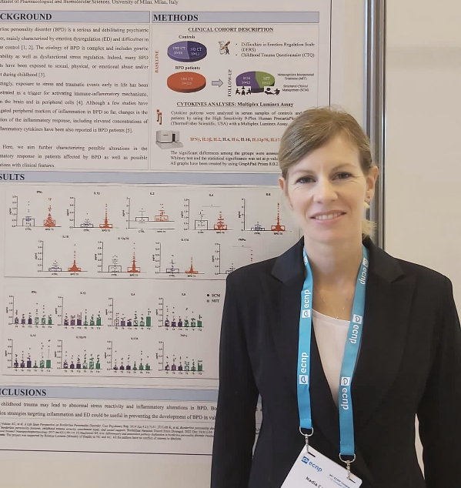
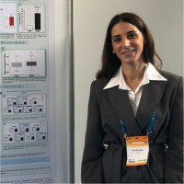
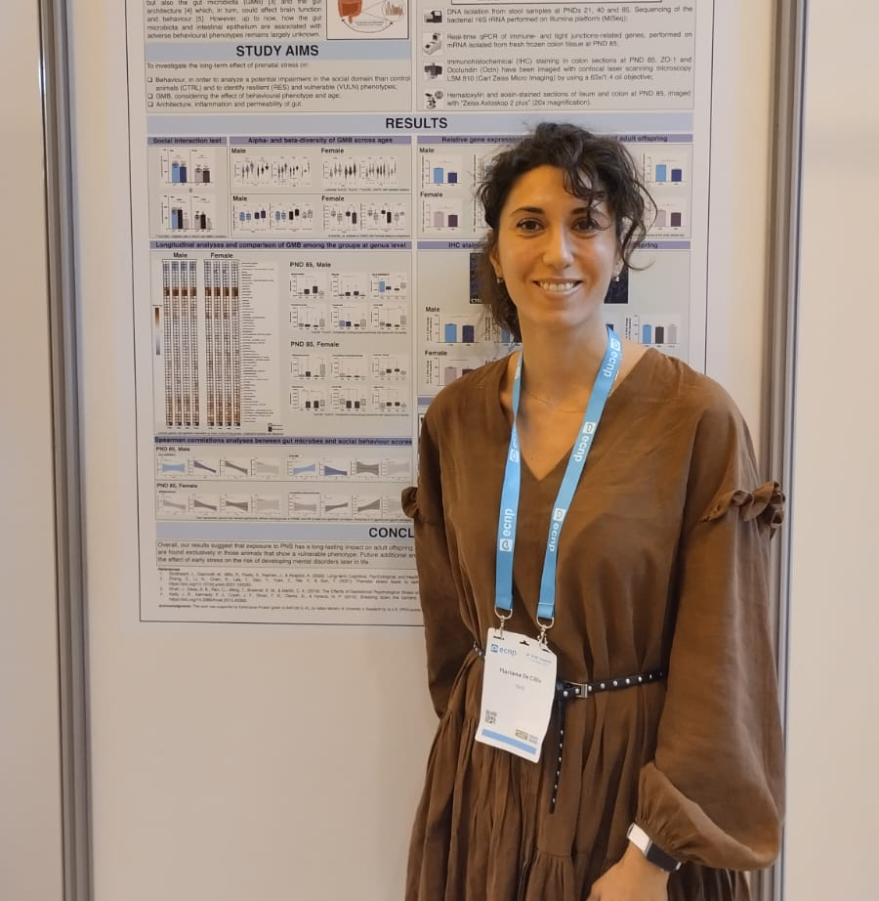

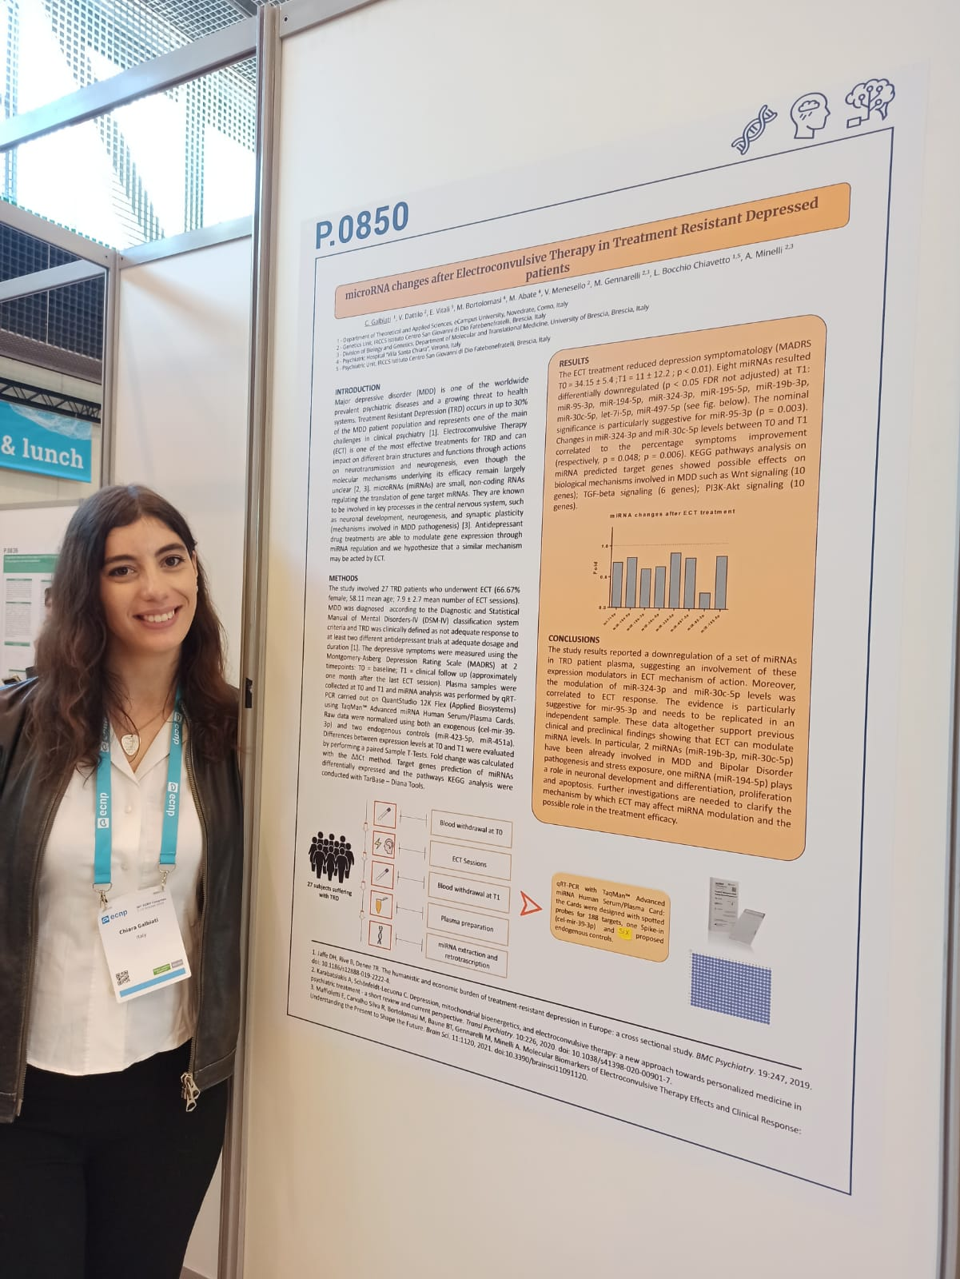
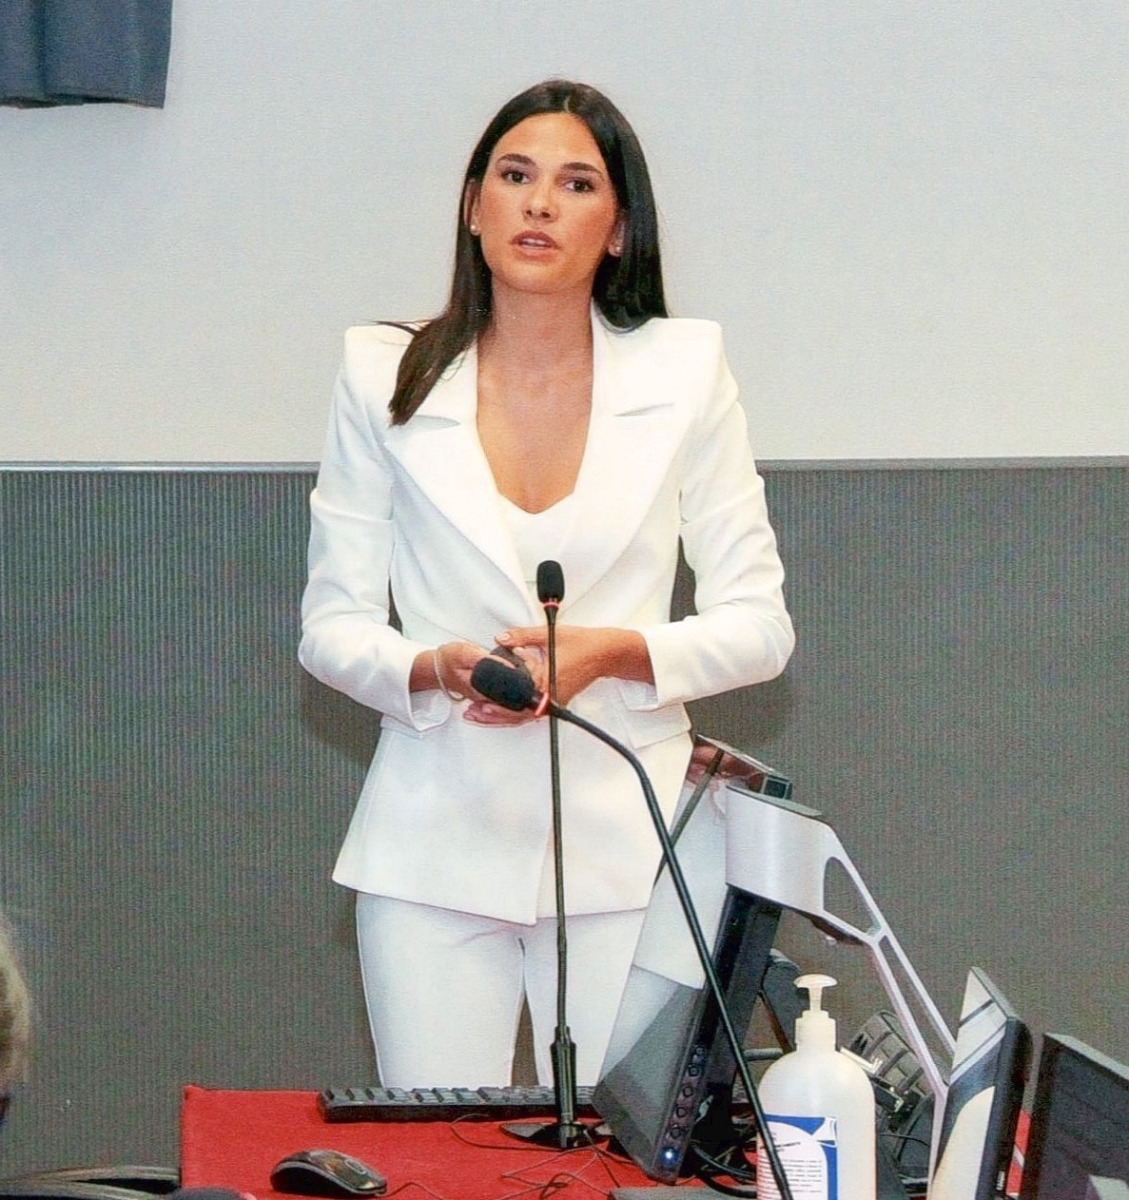

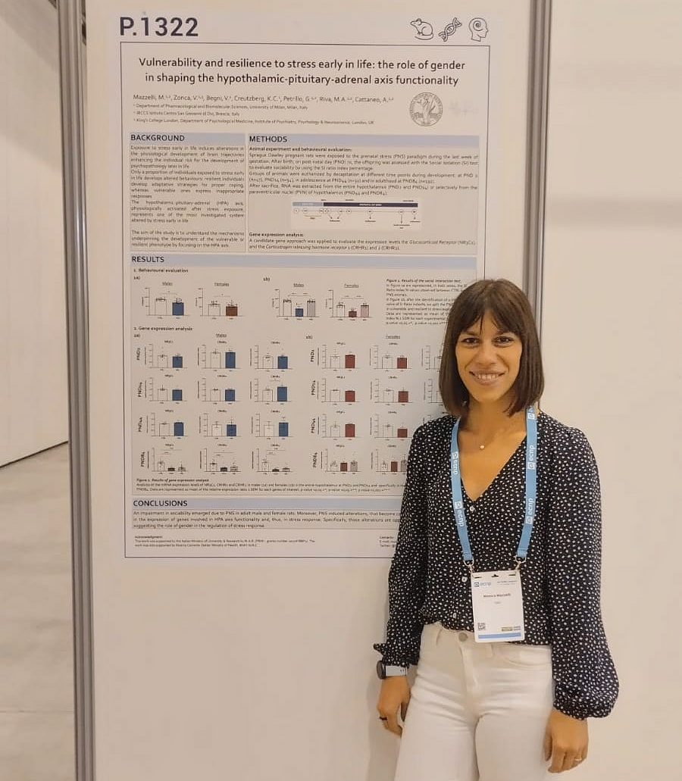
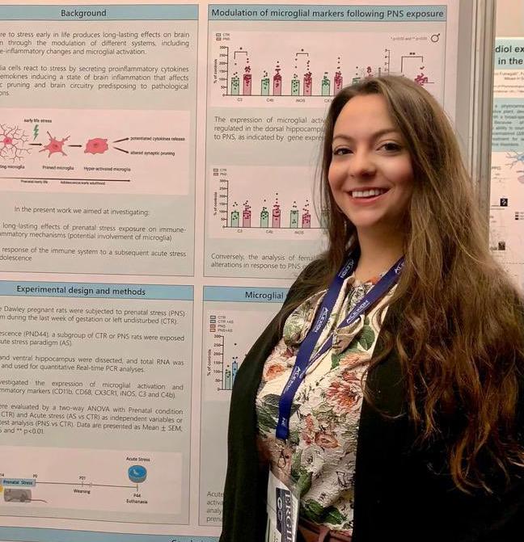
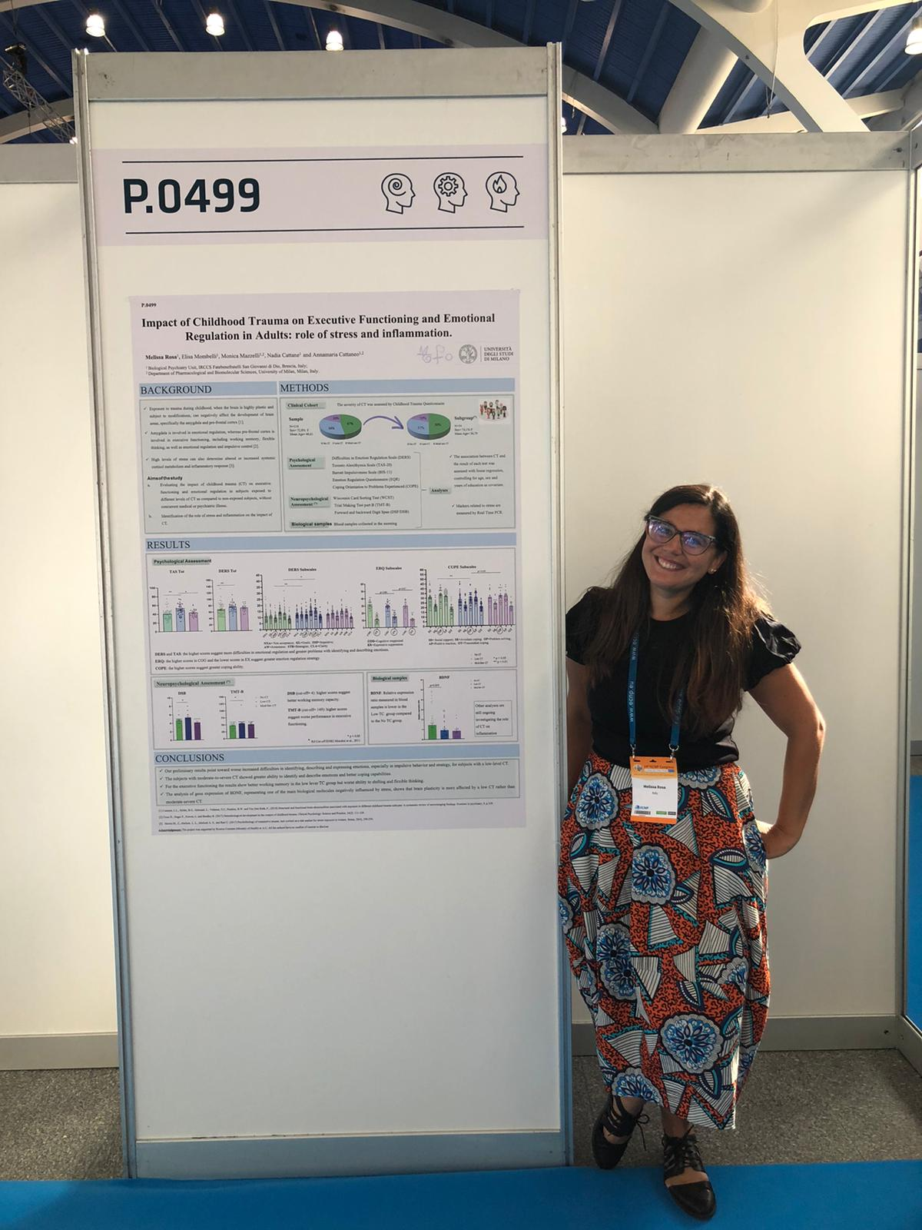


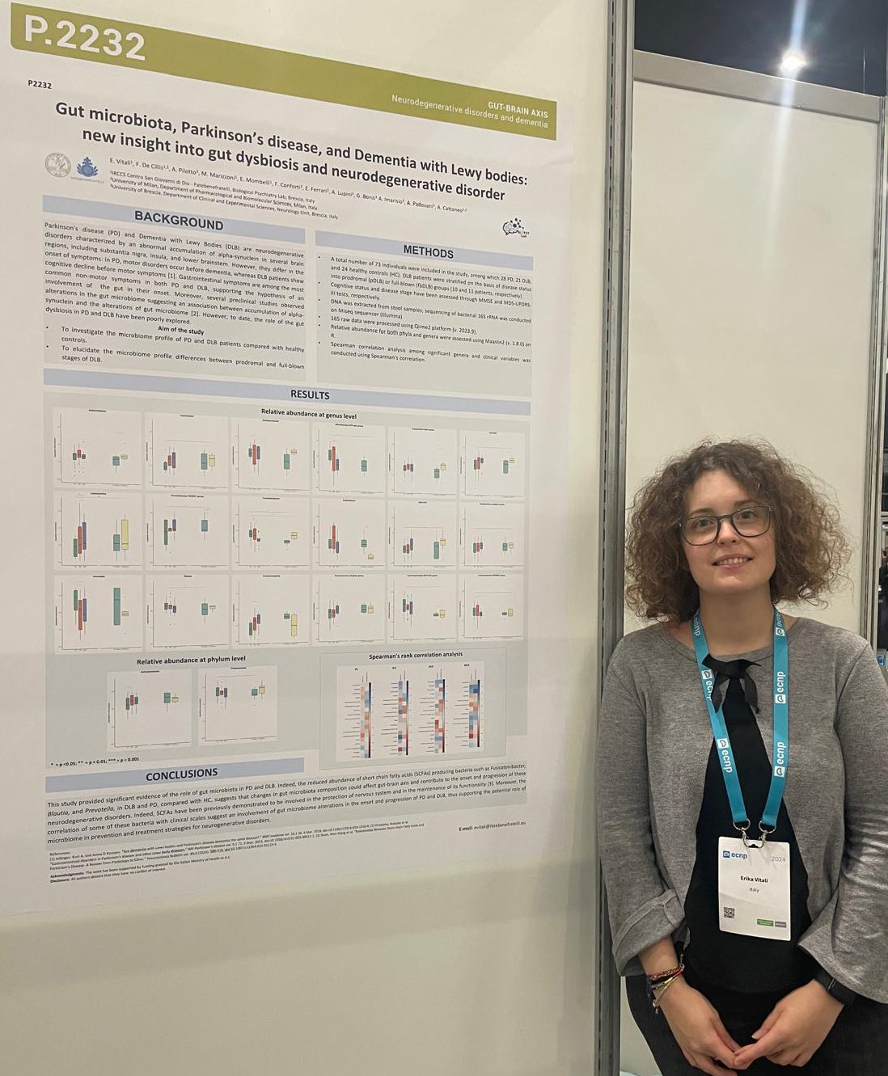
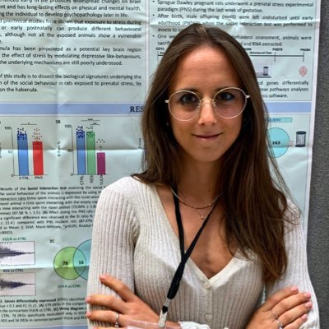

Funding:
Veronica Begni
Chiara Bottanelli
Nadia Cattane
Ilari D’Aprile
Floriana De Cillis
Maria Grazia Di Benedetto
Chiara Galbiati
Patrizia Genini
Moira Marizzoni
Monica Mazzelli
Giulia Petrillo
Melissa Rosa
Samantha Saleri
Catia Scassellati
Erika Vitali
Valentina Zonca
多謝恁的注意!
Thank you for your attention!
Biological Psychiatric Unit
IRCCS Fatebenefratelli Centro San Giovanni di Dio
Brescia, Italy
Department of Pharmacological and Biomolecular Sciences
University of Milan
Milan, Italy

